Slide 1

Twitter Sentiment & Emotion Analysis
Group number:- 01

Slide 2
Group Members
Name | Roll Number
Prathamesh Chikane | 06
Subodh Halpatrao | 18
Sutej Kulkarni | 35

Slide 3
What is Sentiment Analysis?
It is classification of the polarity of a given text in the document, sentence or a phrase
The goal is to determine whether the expressed opinion in the text is positive, neutral or negative.

Slide 4
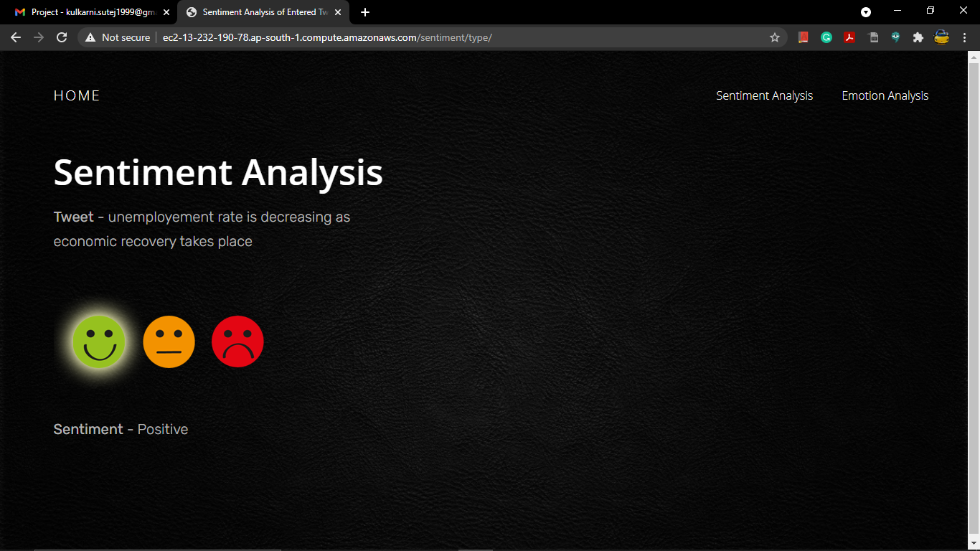
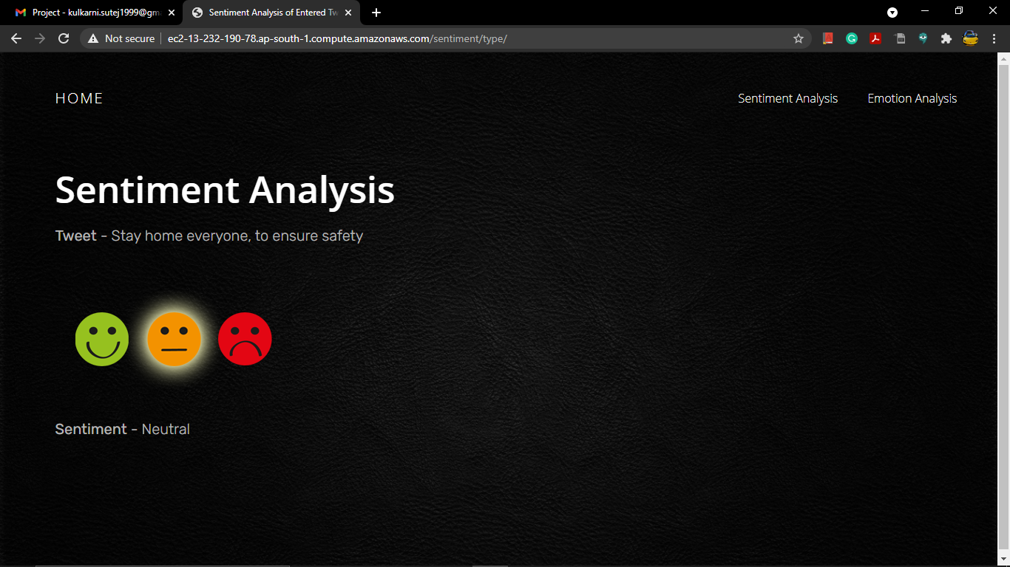
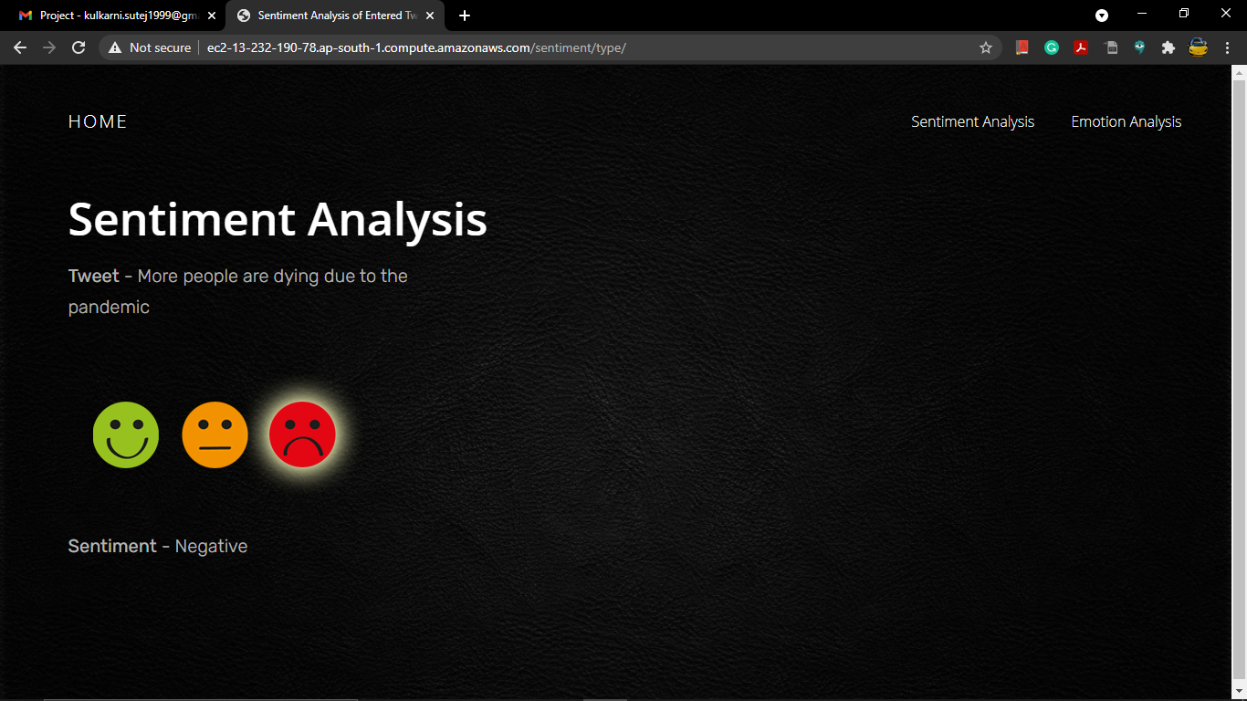

Slide 5
What is Emotion Analysis
Emotions are described as intense feelings that are directed at something or someone in response to internal or external events having a particular significance for the individual. And the internet, today, has become a key medium through which people express their emotions, feelings and opinions
Every event, news or activity around the world, is shared, discussed, posted and commented on social media, by millions of people.
The goal is to determine whether the tweet or sentence is a worry, happy, love or hate based tweet

Slide 6
Why is Sentiment Analysis Important ?
Microblogging has become popular communication tool
Opinion of the mass is important
Political party may want to know whether people support their program or not.
Before investing into a company, one can leverage the sentiment of the people for the company to find out where it stands.
A company might want to find out the reviews of its products

Slide 7
Why we need Emotion Analysis ?
There are plenty of research works that have focused on Sentiment Analysis and provide a 2-way or a 3-way classification of text.
But in recent times there has been more and more types of specifications and classifications needed to get a more specialized result
Capturing the emotions in text, especially those posted or circulated on social media, can be a source of precious information, which can be used to study how different people react to different situations and events.

Slide 8
Using Twitter for Sentiment & Emotion Analysis
Popular microblogging site
240+ million active users
Twitter audience varies from common people to celebrities
Users often discuss current affairs and share personal views on various subjects
Tweets are small in length and hence unambiguous

Slide 9
Problem Statement
The problem statement at hand consists of two subtasks:
Given a message containing a marked instance of a word or a phrase, determine whether that instance is positive, negative or neutral in that context and whether its worry, happy, love and hate in emotion
Phrase Level Sentiment and Emotion Analysis in Twitter:
Given a message, decide whether the message is of positive, negative or neutral sentiment or a happy, worry, love or hate in emotion. For messages conveying mixed sentiment and emotion, whichever is the stronger sentiment should be chosen
Sentence Level Sentiment and Emotion Analysis in Twitter:

Slide 10
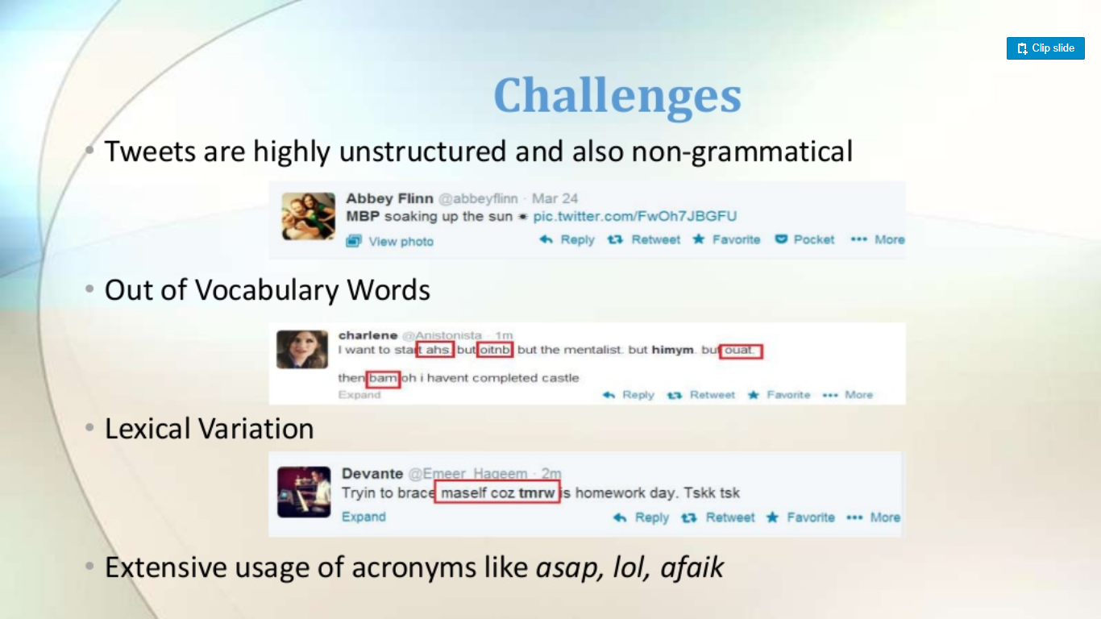

Slide 11
Tweet Downloader
Tokeniser
Preprocessing
Feature Extractor
Performing Sentiment Analysis
Performing Emotion Analysis
SVM Classifier & Prediction
NLP + EWS
Result / Output
Result / Output

Slide 12
Approach
Tweet Downloader:- Download the tweets using Twitter API
Tokenisation:- Twitter specific POS tagger developed by Social Media Search
Preprocessing :- Removing Non-English Tweets, Replacing Emoticons by their polarity, Remove URL, Target Mentions, Hashtags. Remove Nouns and Prepositions, Replace sequence of repeated characters.

Slide 13
Approach
Feature Extractor > Polarity Score of the tweet > Percentage of capitalised words > Number of hashtags > Number of negations
Classifier and Prediction
The Feature extracted are next passed on to SVM classifier for Sentiment Analysis and to the NLP model which carries on the Emotion Analysis
The Model built is used to predict the sentiment and emotion of the tweets.

Slide 14
Design Plan
Dataset
query
Batch view
NLP Tools
query
Batch view
ML Components
Twitter Data
Real time view
Real time view

Slide 15
Implementation Plan
Here’s what our Implementation plan will look like:
Gather real-time live tweets from Twitter
Preprocessing (stopword removal)
Applying the SVM algorithm for Sentiment Analysis & NLP on Emotion Word Set (EWS) for Emotion Analysis
Analyze the results
Discuss further improvement and next steps

Slide 16
Extracting Tweets
We’ll start by grabbing the tweets we want from Twitter, In one of the later stages, we will be extracting numeric features from our Twitter text data. This feature space is created using all the unique words present in the entire data. So, if we preprocess our data well, then we would be able to get a better quality feature space.

Slide 17
Pre-processing Tweets
The preprocessing of the text data is an essential step as it makes the raw text ready for mining, i.e., it becomes easier to extract information from the text and apply machine learning algorithms to it. If we skip this step then there is a higher chance that you are working with noisy and inconsistent data. The objective of this step is to clean noise those are less relevant to find the sentiment of tweets such as punctuation, special characters, numbers, and terms which don’t carry much weightage in context to the text.
Stopwords are words that aren’t integral to the meaning of a text, and are usually removed as part of a Natural Language Processing workflow. The tweets are now reassembled as sentences, but without stopwords removing these extra elements should give the sentiment analysis algorithm a better shot.

Slide 18
Applying the algorithm for sentiment analysis
Choosing which sentiment algorithm to use depends on a number of factors: you need to take into account the required level of detail, speed, cost, and accuracy among other things, Here we have selected the Support Vector Machine algorithm

Slide 19
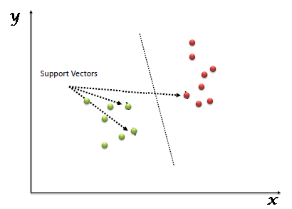
Support Vector Machine (SVM)
“Support Vector Machine” (SVM) is a supervised machine learning algorithm which can be used for both classification or regression challenges. However, it is mostly used in classification problems. In the SVM algorithm, we plot each data item as a point in n-dimensional space (where n is number of features you have) with the value of each feature being the value of a particular coordinate. Then, we perform classification by finding the hyper-plane that differentiates the two classes very well

Slide 20
How SVM Works?
Unlike other classifiers, the support vector machine is explicitly told to find the best separating line. How? The support vector machine searches for the closest points, which it calls the "support vectors" (the name "support vector machine" is due to the fact that points are like vectors and that the best line "depends on" or is "supported by" the closest points).
Once it has found the closest points, the SVM draws a line connecting them. It draws this connecting line by doing vector subtraction (point A - point B). The support vector machine then declares the best separating line to be the line that bisects -- and is perpendicular to -- the connecting line.
The support vector machine is better because when you get a new sample (new points), you will have already made a line that keeps B and A as far away from each other as possible, and so it is less likely that one will spillover across the line into the other's territory.

Slide 21
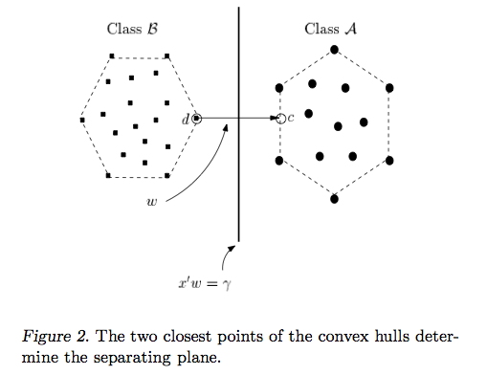

Slide 22
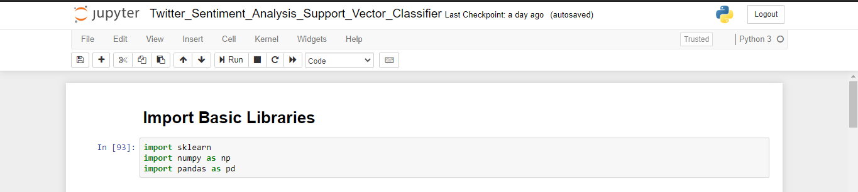
SVM Implementation

Slide 23
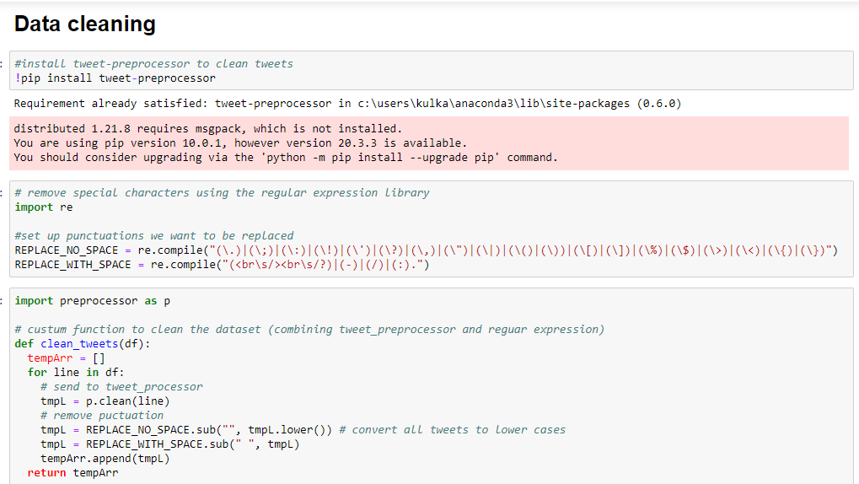

Slide 24
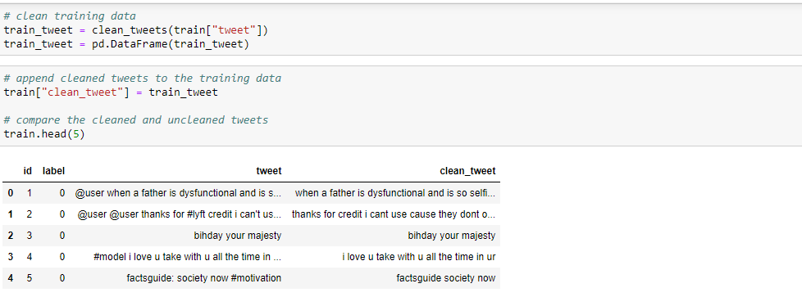

Slide 25
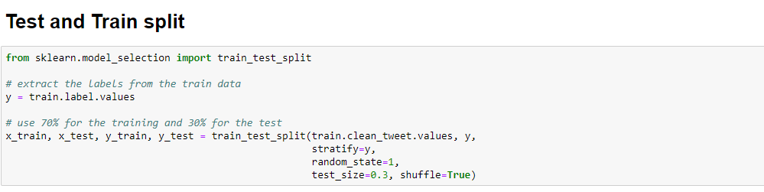

Slide 26
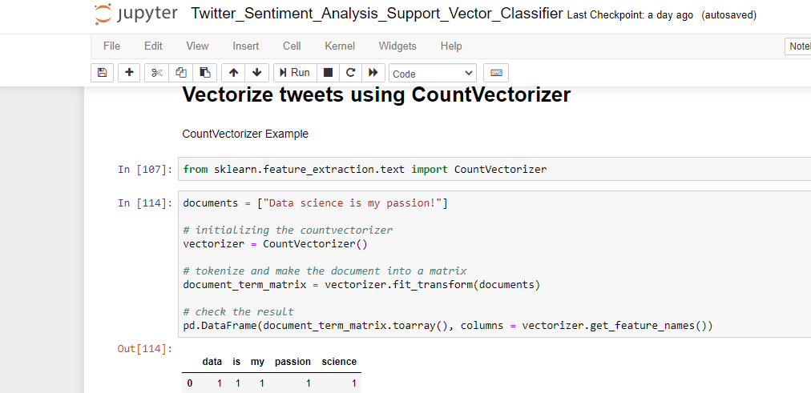

Slide 27
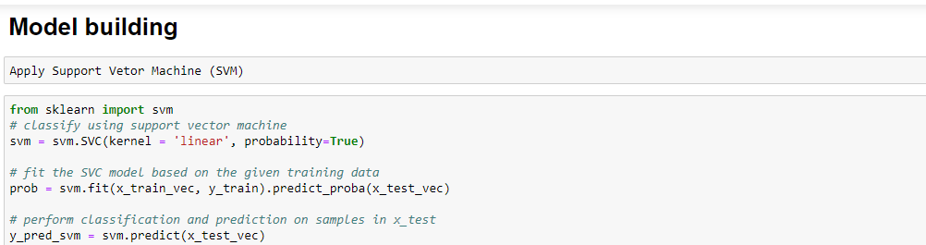

Slide 28
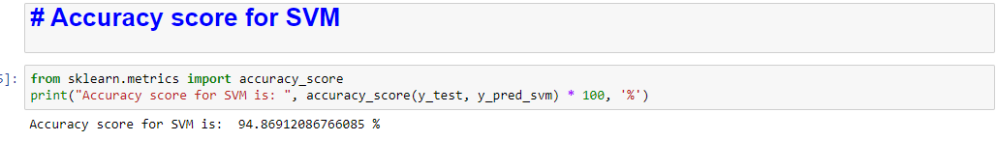

Slide 29
Working of Emotion Analysis Model
Our Emotion analysis is based on Natural Language Processing, and uses several textual features like emoticons, degree words and negations, Parts Of Speech and other grammatical analysis.
Natural Language Toolkit (nltk) which is used for building programs that work with human language data for applying in statistical natural language processing (NLP). It contains text processing libraries for tokenization, parsing, classification, stemming, tagging and semantic reasoning
In this approach we use the tweets in Tweets Set as well as from the live API data

Slide 30
Approach
pos: Parts of Speech (noun, verb, adjective, for example)
lemma: Lemmatized version of that word
Next, the annotated (and filtered) tokens are matched against the words present in the EWS. But first, all the words in the EWS are lemmatized to their base form. Eg. “happiness” and “happily” are changed to “happy”. While matching the tokens against the EWS, only the tokens that are annotated as “O” (the other entity in Named Entity Recognition) are considered, because a named entity (location, time or a person word, for example) can never be an Emotion-word.
A matched token along with all its characteristics/annotations is stored as a hit, Every hit is finally a tuple of its features that contribute in the process.
Finally using the Natural language toolkit (nltk) and textblob we then classify the lemmatized sentence containing the token into Worry, Happy, Sad, Love & Hate whichever emotion it carries.

Slide 31
Hosting on AWS
When compared to traditional web hosting services, AWS comes out as the clear winner in terms of user understandability. AWS makes sure that a user manages and maintains their website without any hassles.
It is designed to make web-scale cloud computing easier for developers and allows maximum scalability and availability for websites and web applications.

Slide 32
Developing the Android App
After successful hosting of our website on AWS, we get an URL of our website to make an android application.
With the help of webview in android and website’s IP address we built an Android app of our website successfully.
Also we implement an animation as splash screen while starting the application.

Slide 33

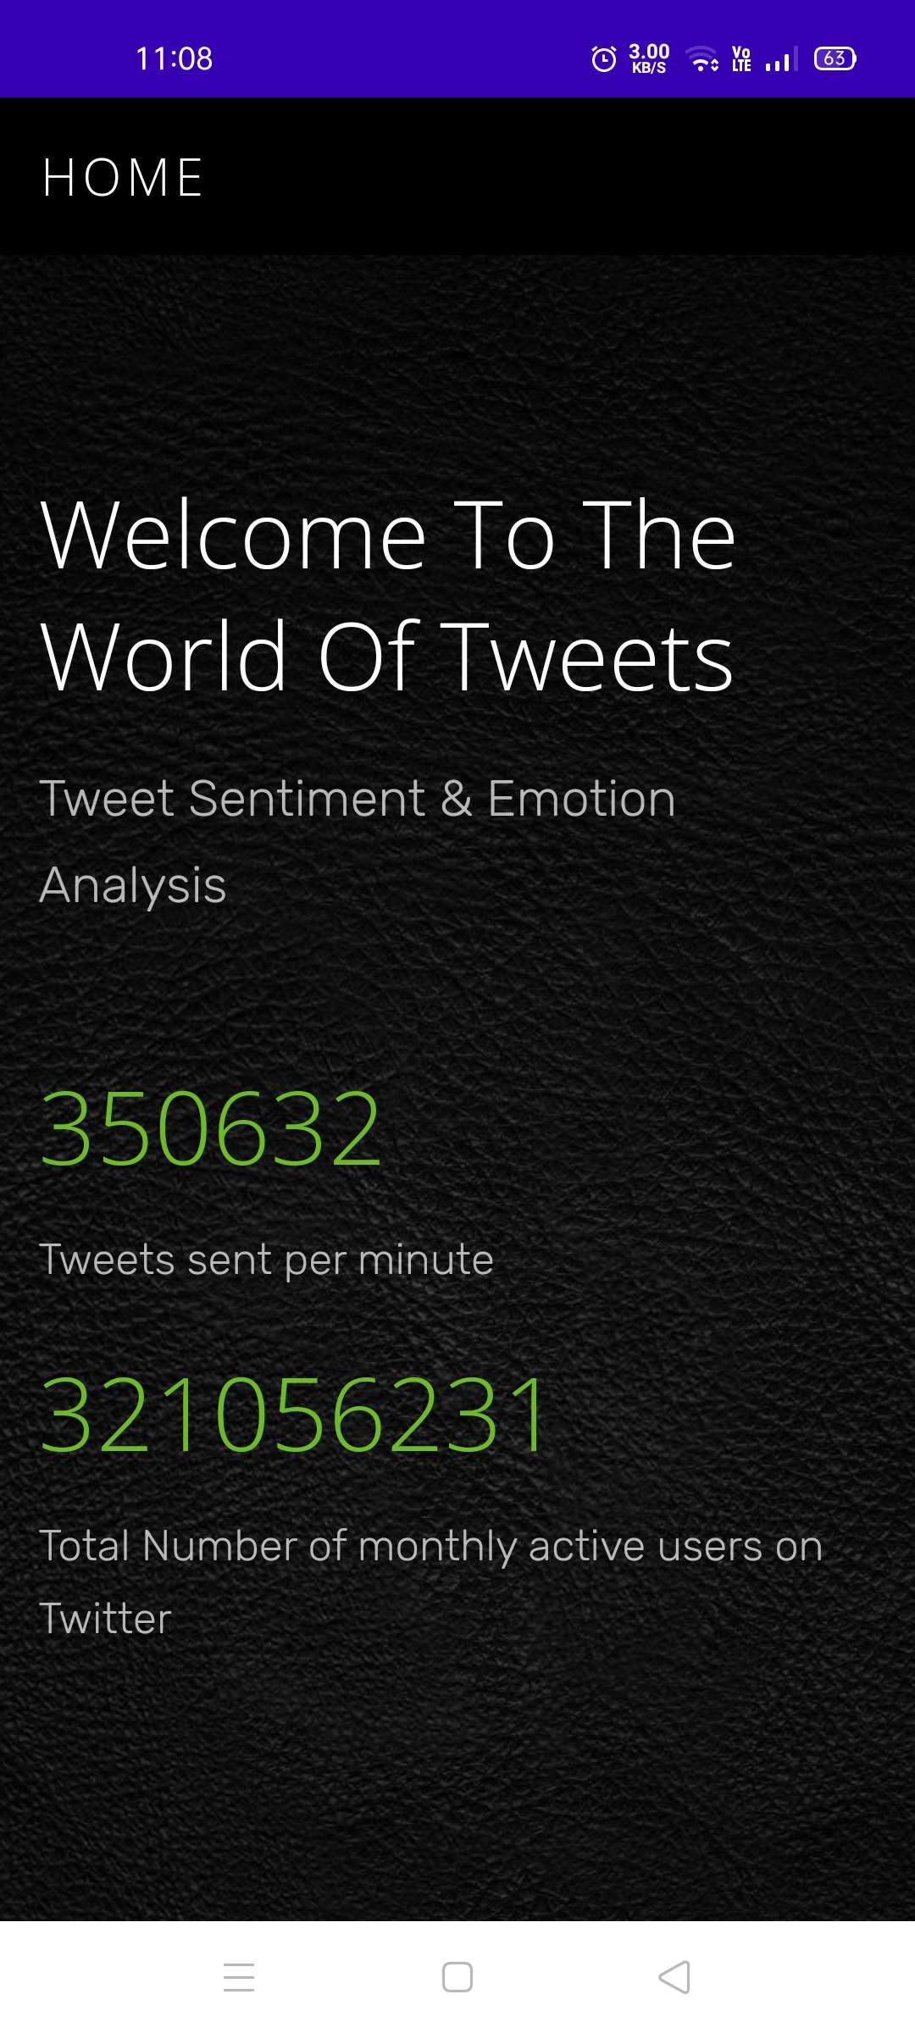
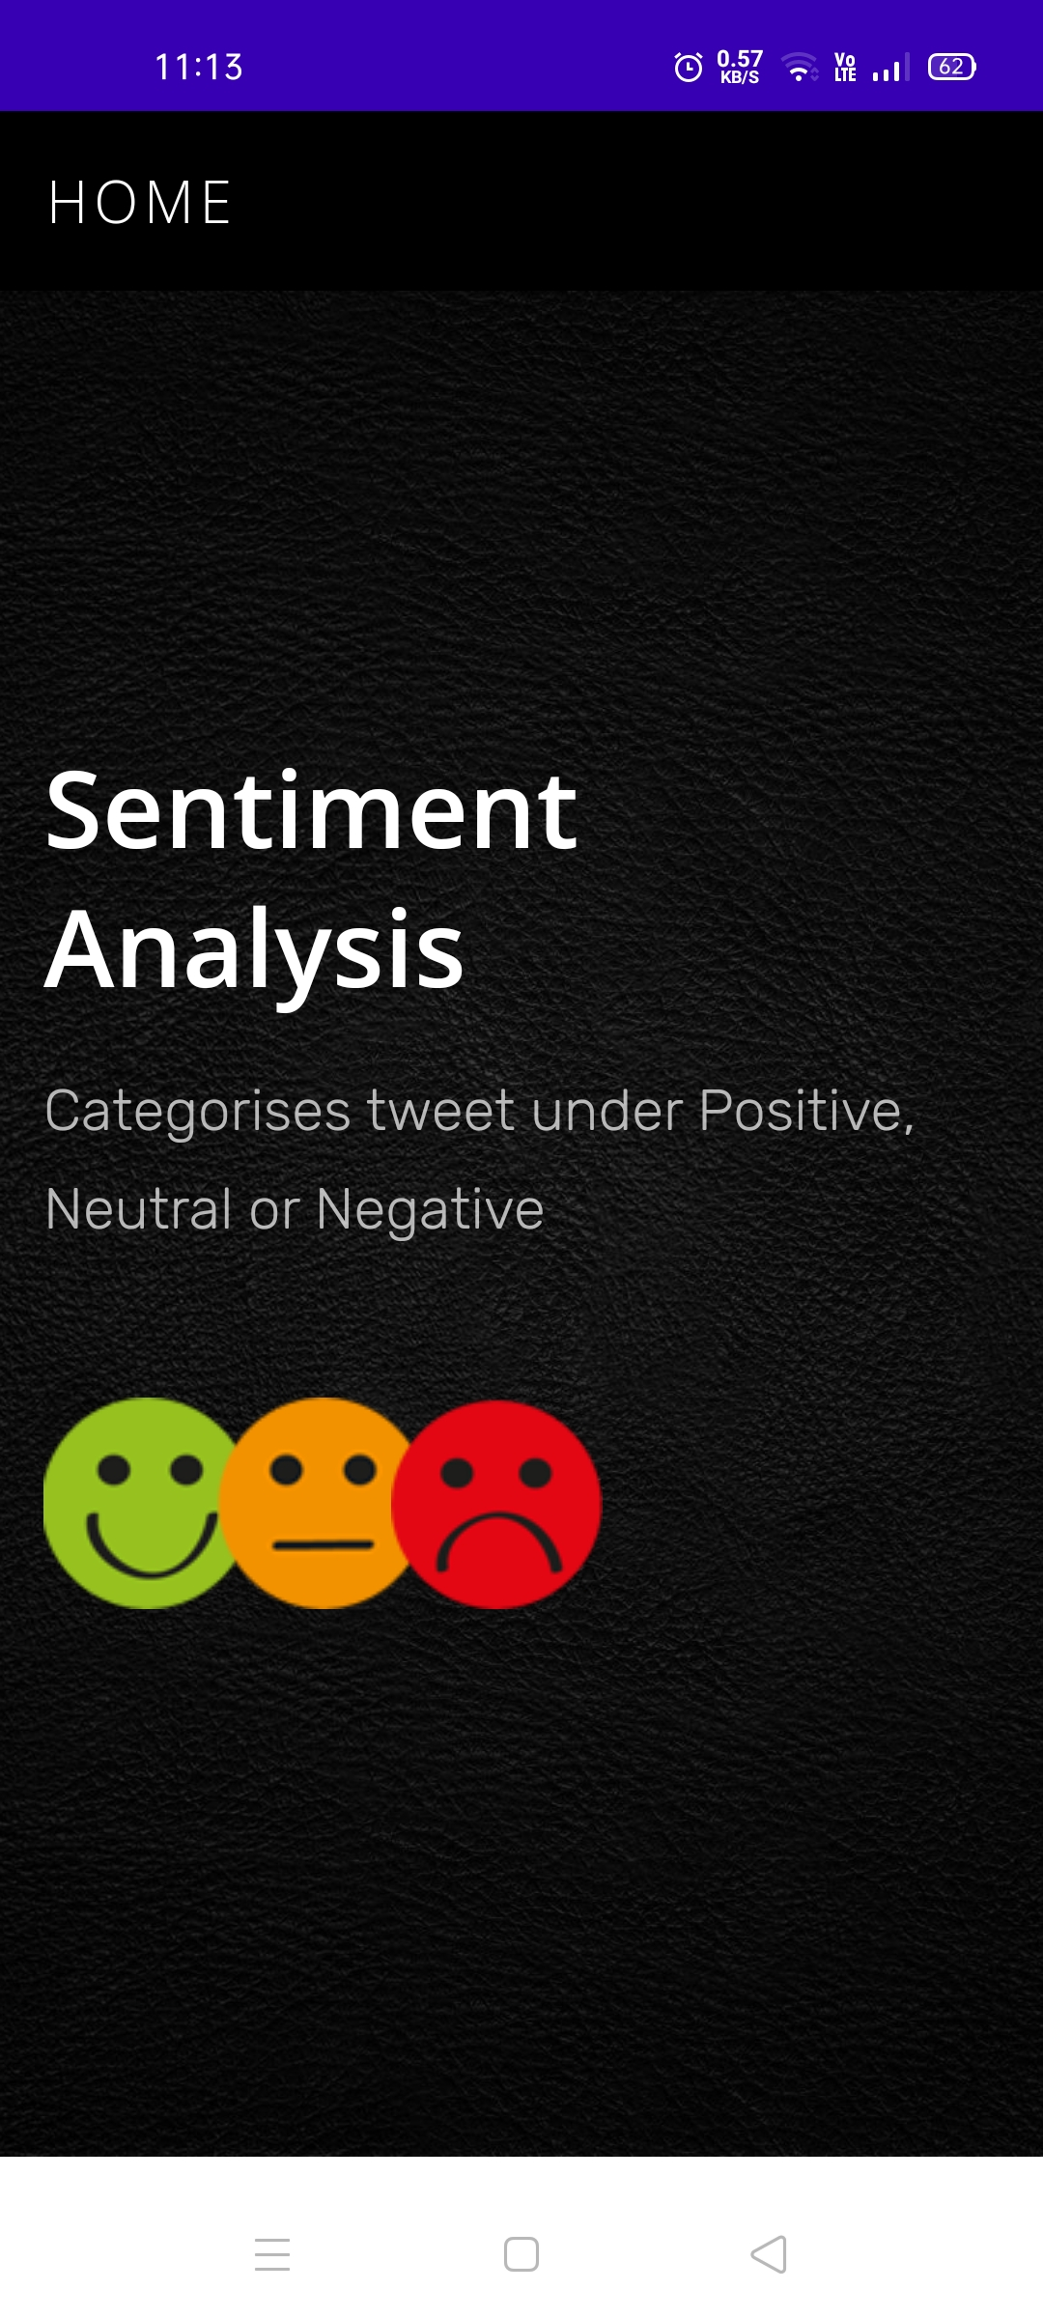
Android App Snapshots

Slide 34
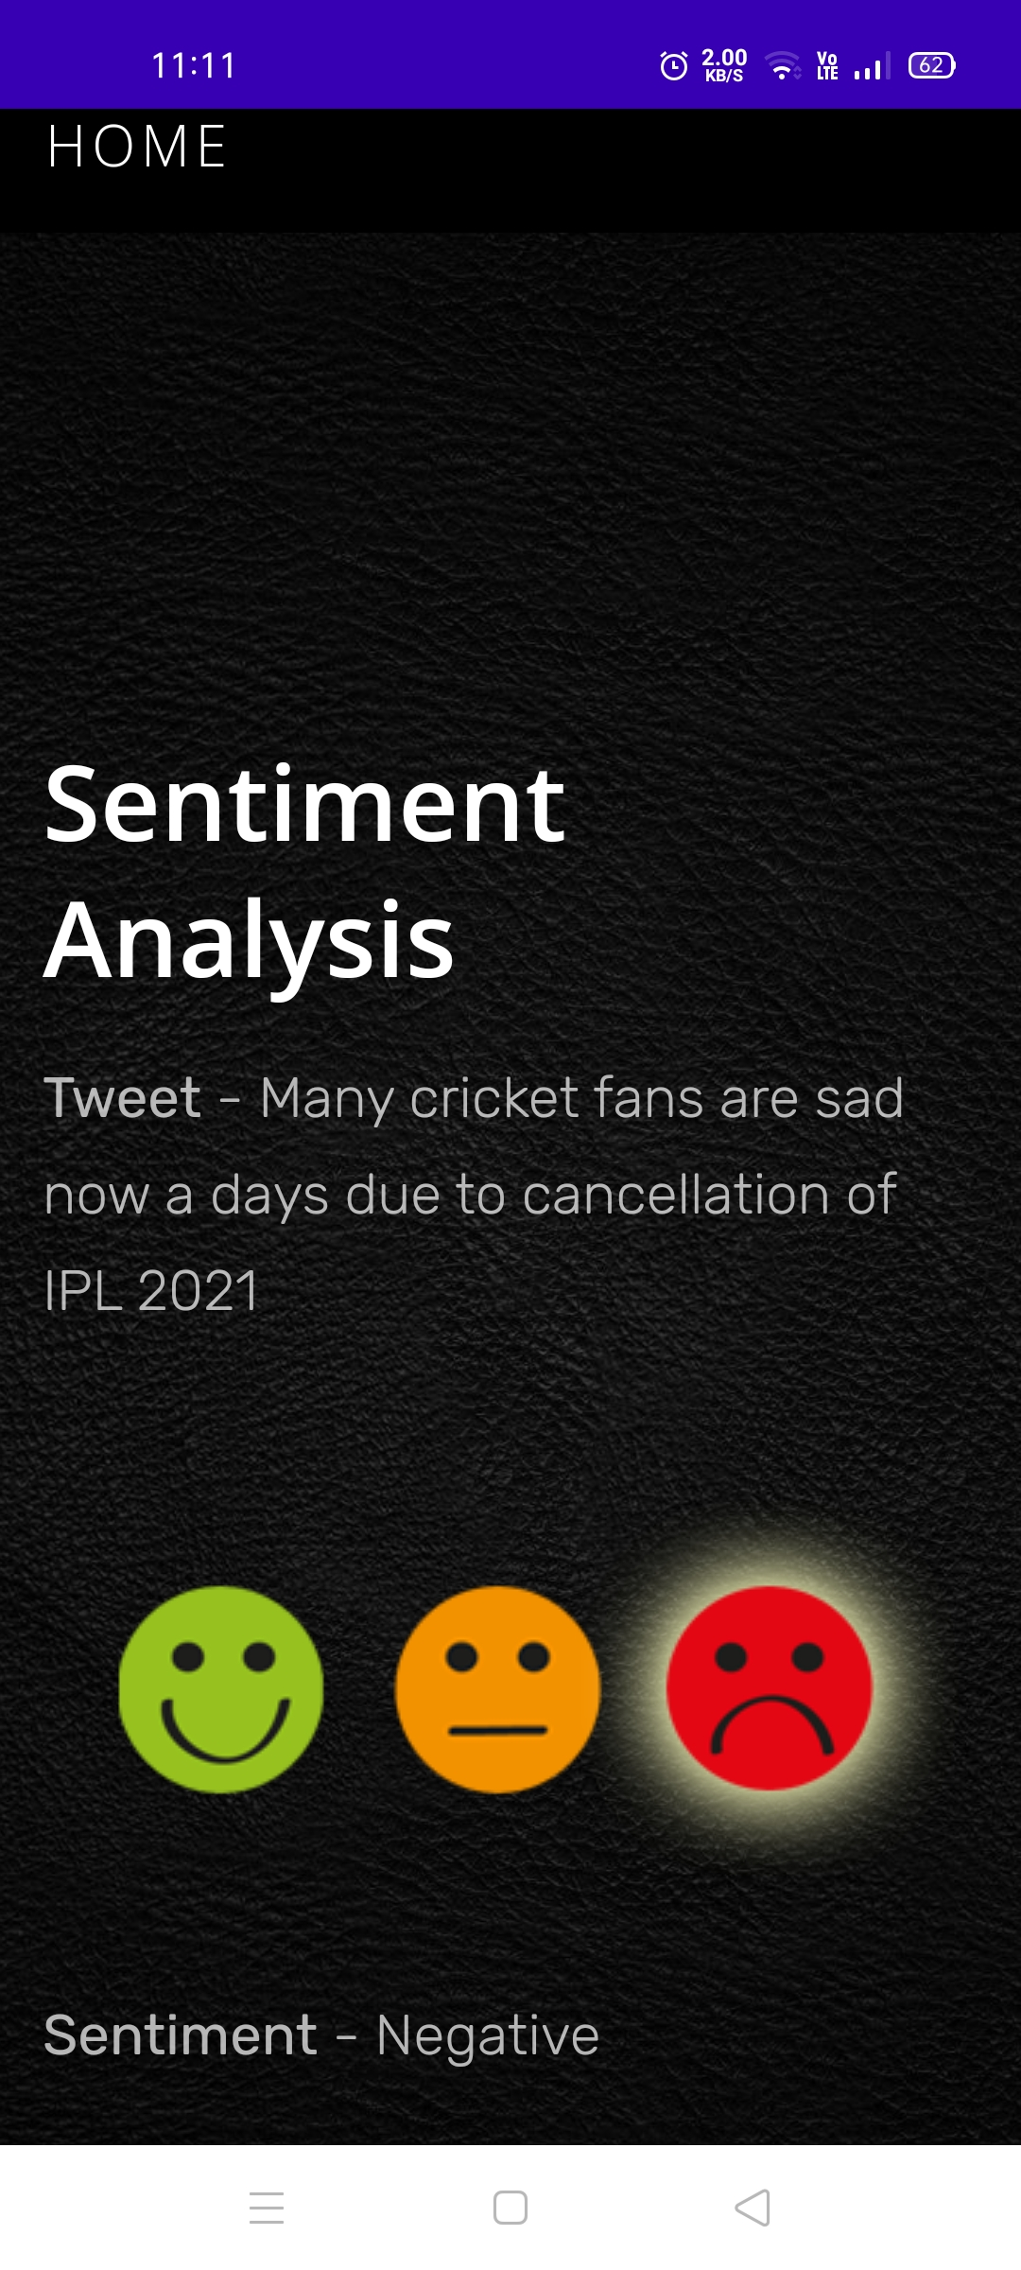

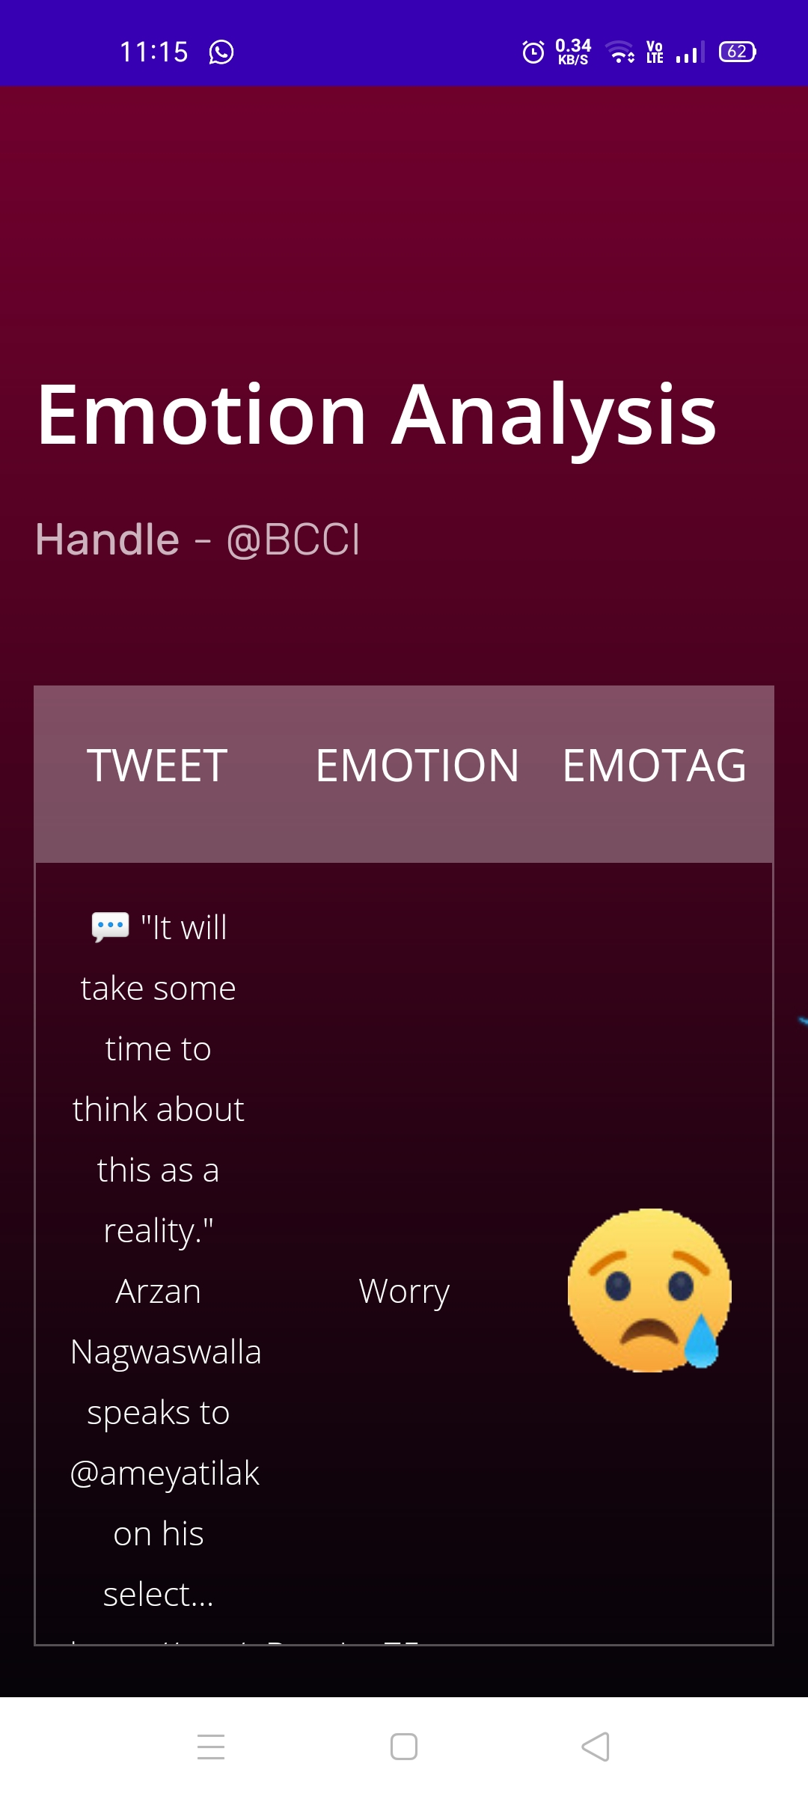

Slide 35
Further Improvements and Next Steps
There are a few ways we can improve this pipeline to make it look more like something production ready.
Use Geolocation and Google Maps API to get location wise sentiments and emotion regarding the sentence or tweet
Using other Social Media Platform’s API and integrating all the combined results

Slide 36
CONCLUSION
We have successfully designed and developed a sentiment and emotion analysis model using Machine learning algorithms and have hosted the project on amazon web services (aws), Also an Android App of our web model is being developed using Android Studio.

